Slide 1
MACHINE LEARNING LINEAR REGRESSION PROJECT
AYESHA IMRAN
2023-BS-AI-061
BSAI-4A

Slide 2
PROJECT INTRODUCTION
Title: House Price Prediction using Machine Learning
Goal: To preprocess a housing dataset and build a regression model to predict house prices.
Why it matters? Accurate price predictions help buyers, sellers, and real estate investors make better decisions.

Slide 3
DATASET: House Price Prediction
Source: Kaggle CSV file with house sale data
Features include:
Area
Number of rooms
Year built
Location info
Target: SalePrice (price of house)
Challenge: Raw data contains missing values, outliers, and mixed data types.

Slide 4
Preprocessing Steps
Missing Values:
Dropped high-missing columns
Filled numerical columns with mean/median
Filled categorical with mode or 'None'
Outliers & Noise:
Used Z-score/IQR to detect and remove outliers
Categorical Encoding:
Label Encoding & One-Hot Encoding
Feature Engineering:
Created new columns (e.g., House Age)
Scaling:
Applied StandardScaler or MinMaxScaler
PCA (Principal Component Analysis):
Reduced dimensionality to retain key variance
Helps avoid overfitting and improves model speed

Slide 5
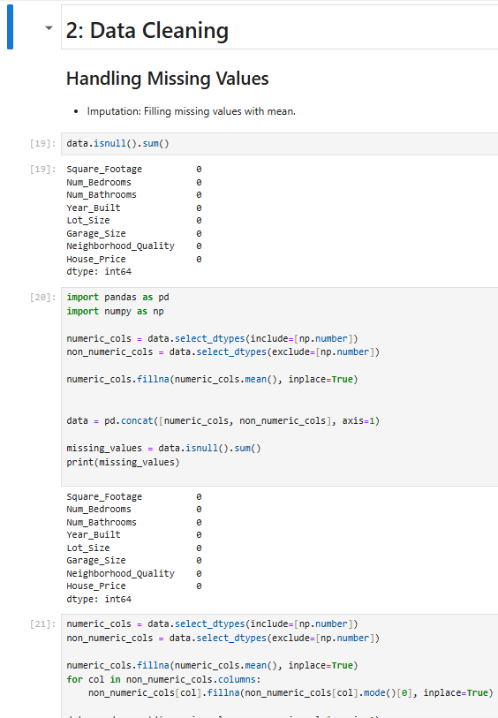
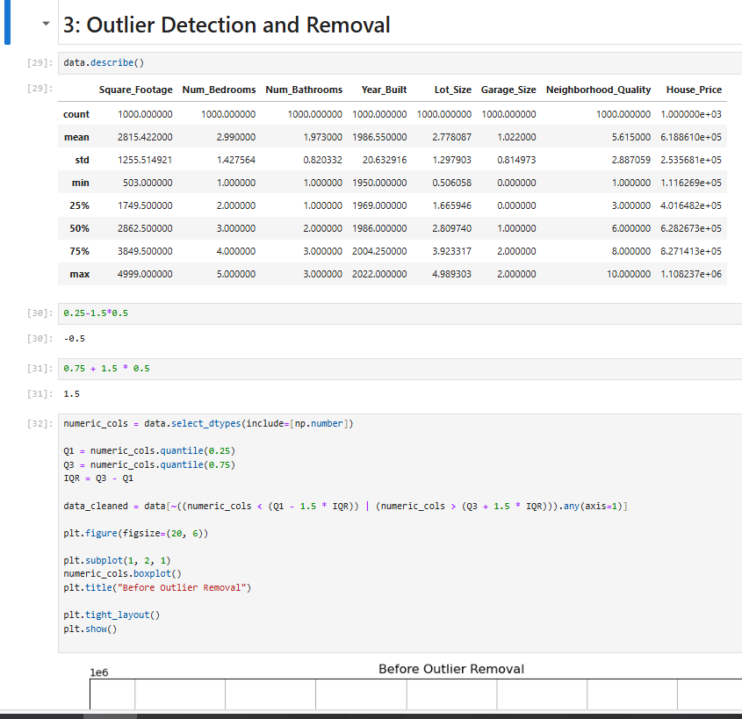
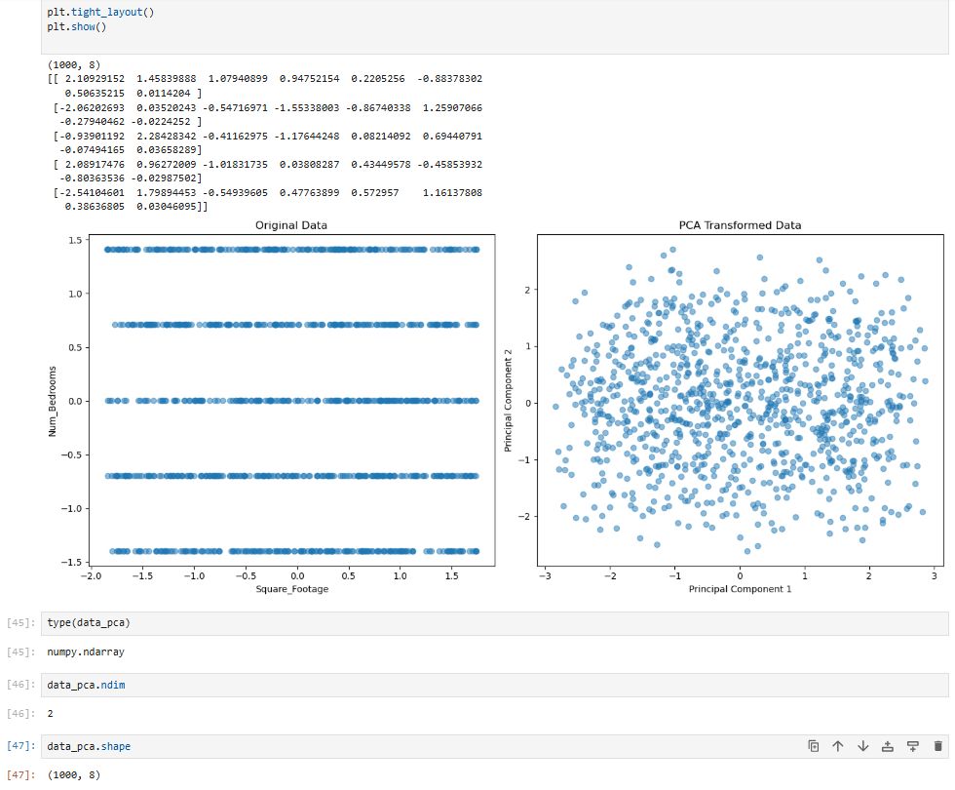

Slide 6
MODELING
Type: Regression Problem
Algorithms:
Linear Regression or similar regression models
Why Regression?
Output is continuous (house price)
Goal is to minimize prediction error

Slide 7
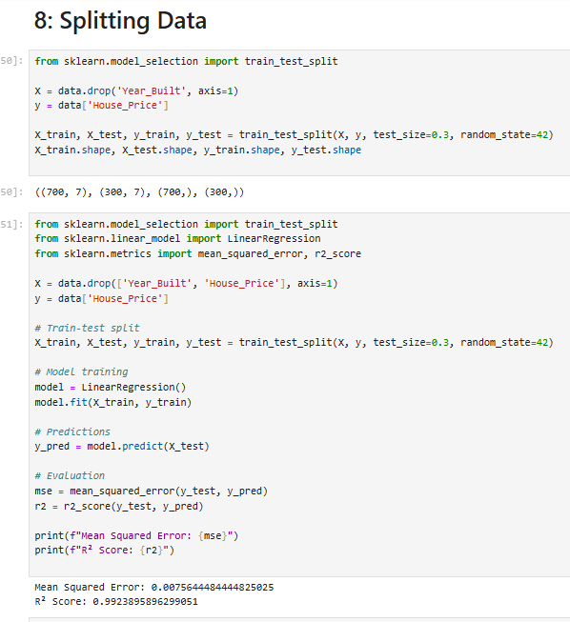
EVALUATION
Metrics used:
Mean Absolute Error (MAE)
Root Mean Squared Error (RMSE)
R² Score
How we evaluated:
Compared predicted prices with actual test set prices
Visualized errors with plots (e.g., residuals, predictions vs actual)

Slide 8
KEY FINDINGS
House age, number of rooms, and location strongly impact price
Data quality and feature engineering significantly improved performance
Proper preprocessing helps build more accurate models

Slide 9
CONCLUSION
Successfully cleaned and prepared real-world data
Built a reliable model to predict house prices
Set foundation for further improvement with more advanced models
“Better data leads to better models.”

Slide 10
THANK
YOU

